Slide 1
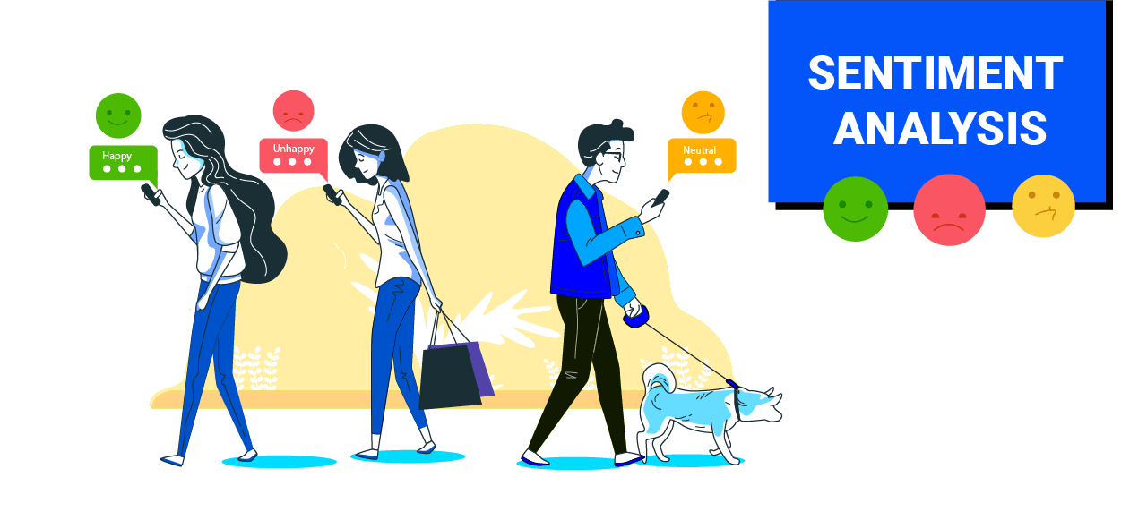

Slide 2
Introduction :
Sentiments are feelings, opinions, emotions, likes/dislikes, good/bad✓
Mention the widespread use of social media platforms like Twitter, Facebook, and Instagram for expressing opinions and emotions.
Social Sentiment refers to the emotion behind a social mention.
It means monitoring social media posts and discussions, then figuring out how participants are reacting.
It involves applying natural language processing (NLP) to social mentions and determining whether the user is responding in a positive, negative or neutral manner.

Slide 3
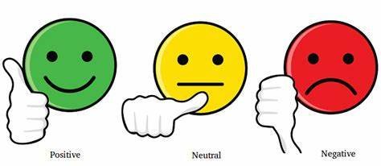
It is a task of identifying whether the opinion expressed in a text is positive or negative.
Automatically extracting opinions, emotions and sentiments in text.
It involves checking how many negative and positive keywords are present in a chunk of conversation..
If there are more positive keywords, it is considered positive content and If there are more negative keywords, it is called negative content.

Slide 4
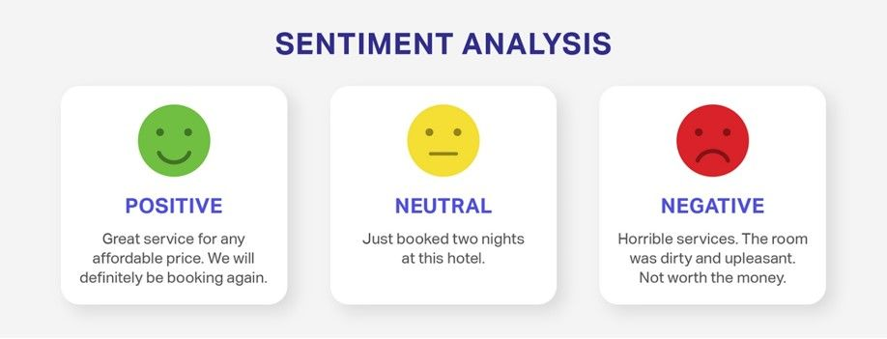
Examples of Sentiment text :
Positive sentiment:
"I absolutely love the new product! It's amazing and works like a charm."
Negative sentiment:
"The movie was a complete letdown. I expected much more from such a hyped-up film."
Neutral sentiment:
"Just finished my work for the day. Time to relax and unwind."

Slide 5
Here are the applications of social media sentiment analysis :
Brand Monitoring
Customer Feedback Analysis
Product Reviews
Market Research
Brand Reputation Management
Political Analysis
Customer Support
Content Strategy

Slide 6
Why we need sentiment analysis :
Improved customer service
Prevent social media crises
Measure the results of a social media campaign
Monitor your competitors
Improve your product according to your customers needs

Slide 7
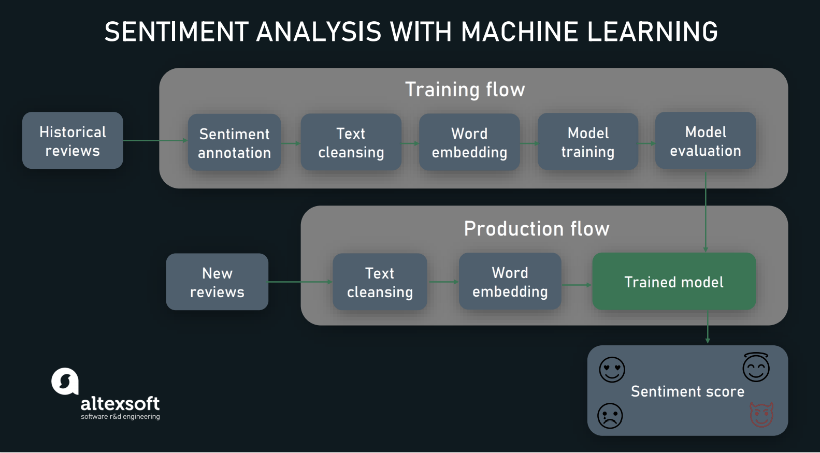

Slide 8
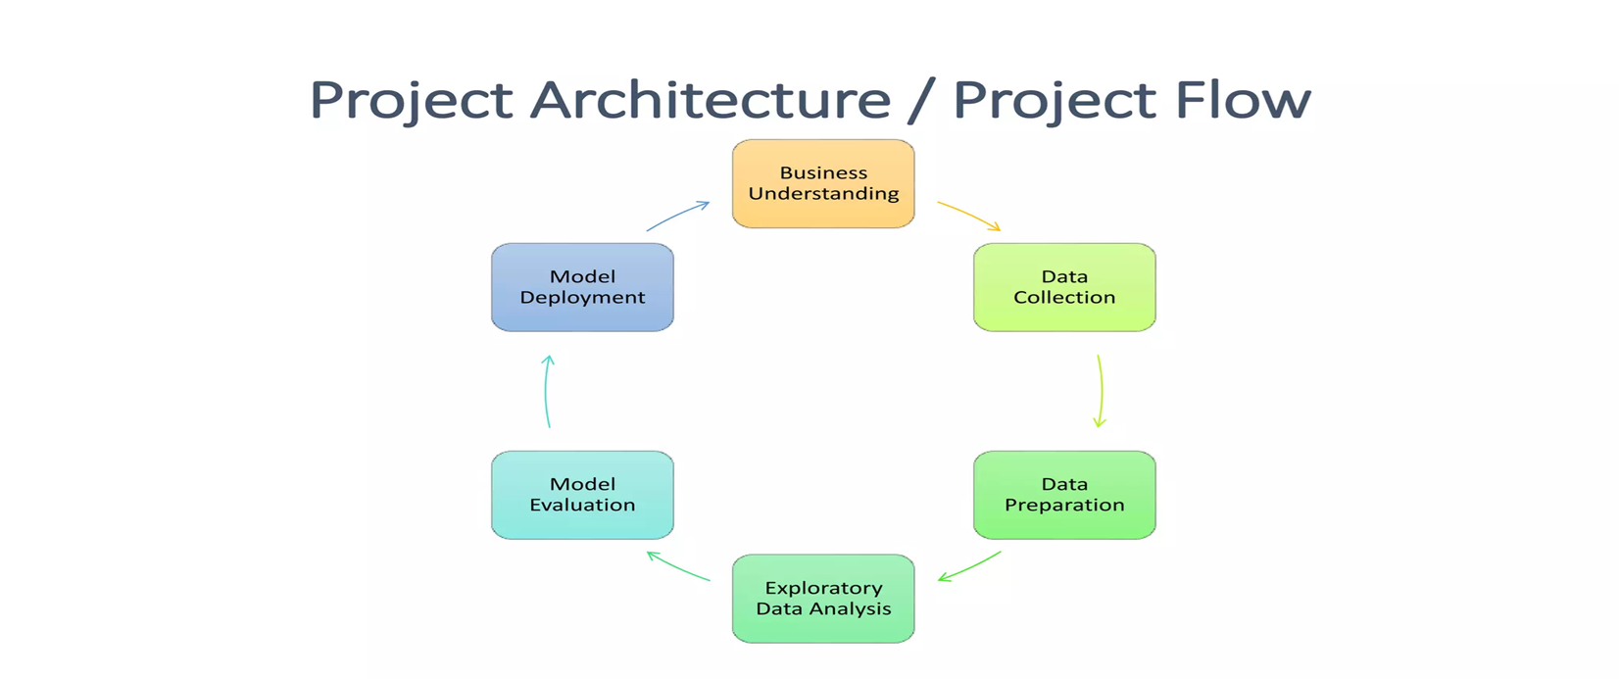
Project Overview and Scope

Slide 9
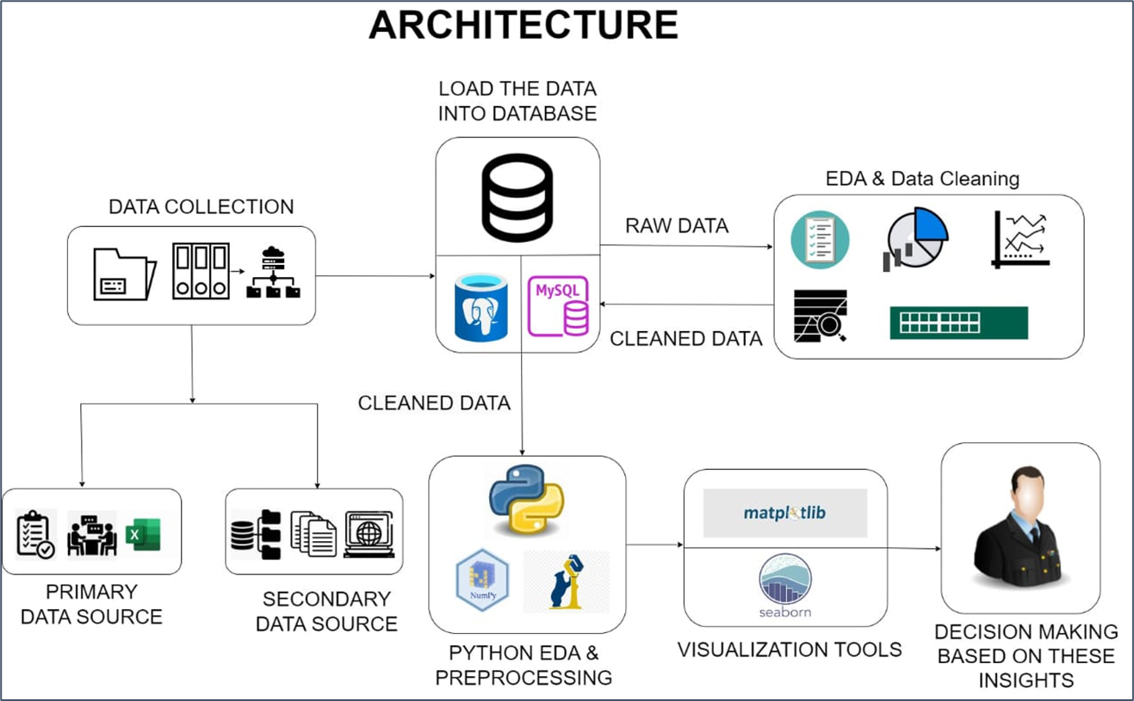

Slide 10
Business Objective :
Business objective is to leverage sentiment analysis on Twitter data to gain actionable insights that drive business growth, improve customer satisfaction, manage reputation, and inform strategic decision-making.

Slide 11
Data Collection and Understanding
• Explore Kaggle's website for Twitter Sentiment datasets.
• Select a dataset that aligns with research objectives.
•We Download the dataset in various formats like CSV.
• Perform exploratory data analysis (EDA) to understand the dataset's characteristics.
• Gain a deeper understanding of the data by visualizing key insights.
• Ensure data is appropriately labeled for supervised learning tasks like sentiment analysis.

Slide 12
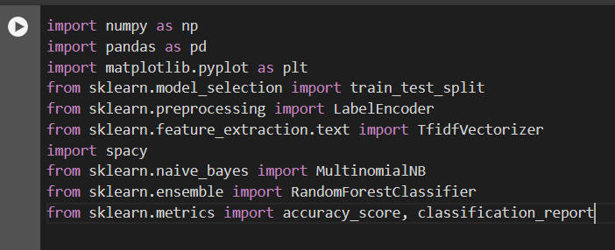
Import all the necessary libraries

Slide 13
Data Preprocessing
While using google collab python we exploring the data.
Renames columns, drops unnecessary columns (like 'Tweet ID’).
Check and drop the null values.
Check and drop the duplicate values.
The purpose of data preprocessing is to ensure data quality, handle missing values, standardize data formats, encode categorical variables, scale numerical features, and perform other necessary transformations.

Slide 14
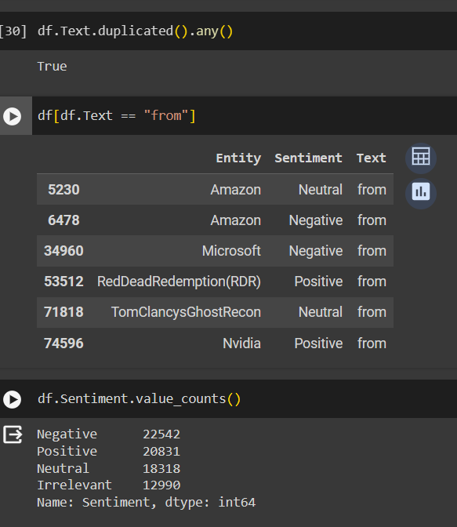
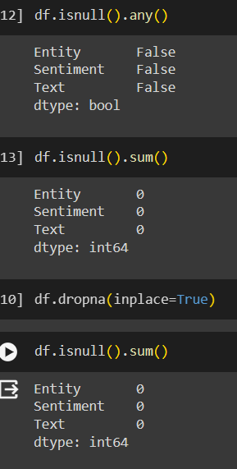
Duplicate values Null values

Slide 15
Preprocessing text
Define a function named preprocess_data to preprocess text data.
Check if the text is a float, convert it to a string if necessary.
Tokenize the text using SpaCy (nlp), which includes tokenization, lemmatization, and handling punctuation and stop words.
Filter out punctuation and stop words from tokens.
Lemmatize tokens to get their base forms.
Join the filtered and lemmatized tokens back into a preprocessed text string.
Apply this preprocessing function to the 'Text' column of the DataFrame and store the preprocessed text in a new column named 'preprocessed_data'.

Slide 16
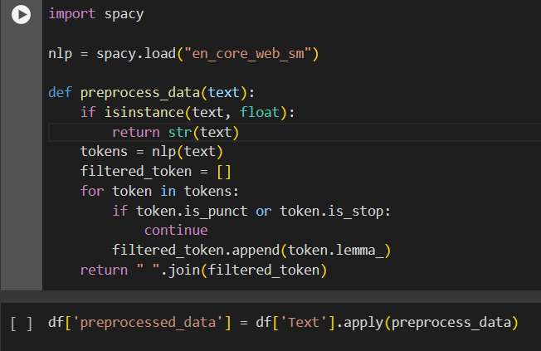
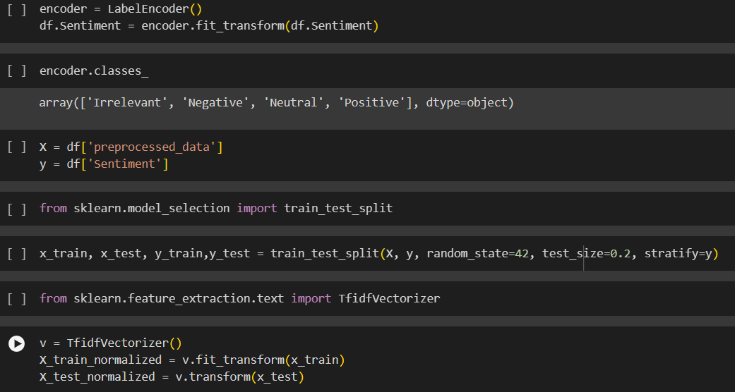

Slide 17
Training different models
The code provided implements two machine learning models for sentiment analysis: Multinomial Naive Bayes (NB) and Random Forest (RF) classifiers.
Multinomial Naive Bayes (NB) Classifier:
Multinomial Naive Bayes classifier is a probabilistic model based on Bayes' theorem.
The code fits the NB classifier (nb_clf) using the training data after converting text features into numerical representations using TF-IDF vectorization.
The code calculates and prints the accuracy score are 0.72 and classification report which includes metrics like precision, recall, and F1-score for each sentiment class.
Random Forest (RF) classifiers
Random Forest is an ensemble learning method that constructs multiple decision combines their predictions to improve accuracy and reduce overfitting.
The code trains a Random Forest classifier (rf_clf) using the TF-IDF transformed training data.
The code evaluates the RF classifier's performance by calculating the accuracy score are 0.90 and generating a classification report with detailed metrics for each sentiment class.

Slide 18
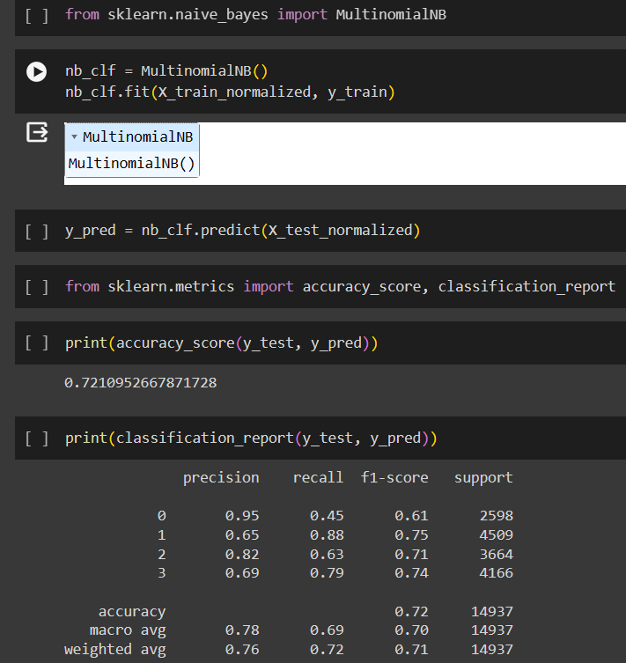
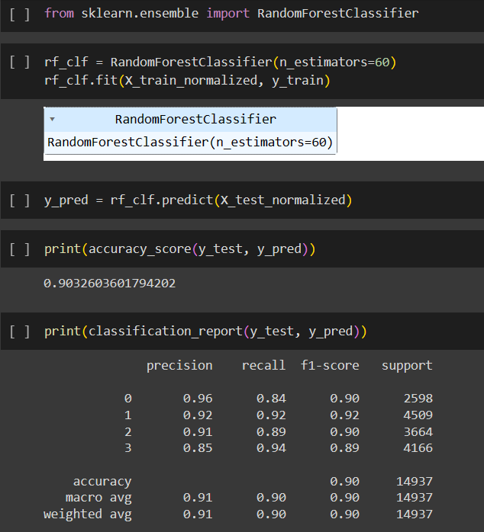
Multinomial Naive Bayes (NB) Random Forest (RF)

Slide 19
Testing now on data
Splits the data into training and testing sets.
It preprocesses a specific tweet from the validation data ('Text' column) using the defined 'preprocess_data' function.
The preprocessed tweet is transformed using TF-IDF vectorization for testing.
The Random Forest classifier (rf_clf) predicts the sentiment of the preprocessed tweet.
The predicted sentiment is compared with the true sentiment value from the validation data.
The code prints the predicted sentiment output, corresponding sentiment label, and true sentiment value for the tested tweet.

Slide 20
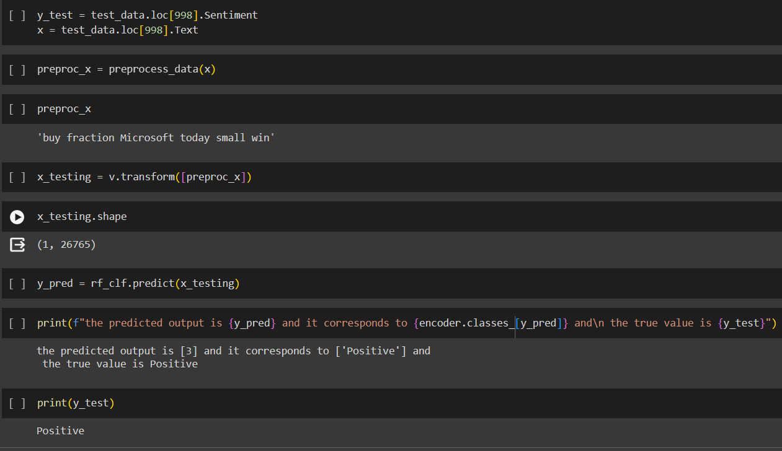

Slide 21
Web application :
This line creates a dictionary (sentiment_labels) that maps numeric sentiment labels to their corresponding sentiment categories. For example, 0 is mapped to 'Irrelevant', 1 to 'Negative', 2 to 'Neutral', and 3 to 'Positive
Streamlit App Main Function: This code defines the main function, which is the core of the Streamlit web application.
It sets the title of the web app to 'Sentiment Analysis Web App' and displays a message prompting the user to enter text for sentiment analysis.
It creates a text area using st.text_area where users can input their text for analysis.
When the user clicks the 'Analyze' button (st.button('Analyze')), it checks if there is text input. If there is, it calls the predict_sentiment function to predict the sentiment of the input text, retrieves the corresponding sentiment label from sentiment_labels, and displays the sentiment label using st.write.
If there is no text input when the 'Analyze' button is clicked, it displays a warning message asking the user to enter some text for analysis.

Slide 22
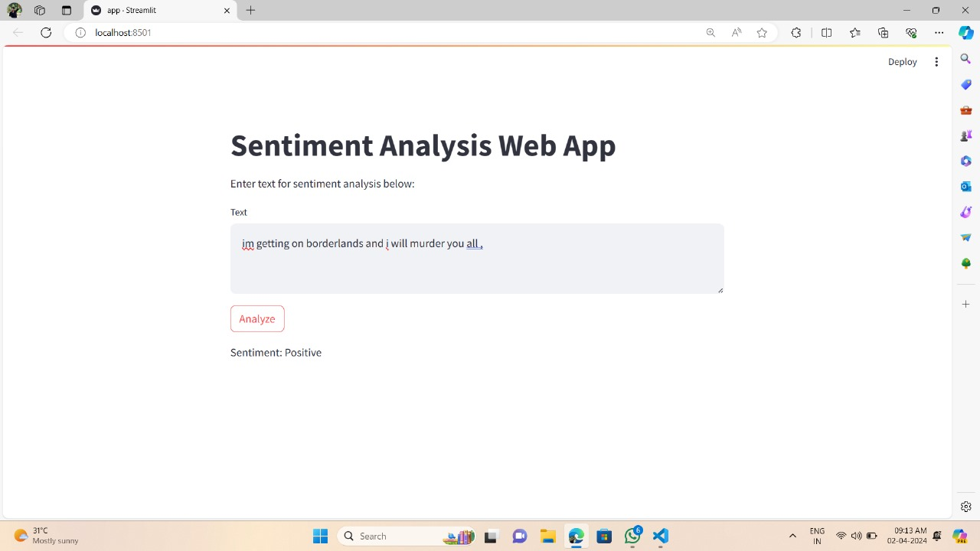

Slide 23
Conclusion
In conclusion, the code presented showcases a comprehensive approach to sentiment analysis on Twitter data using machine learning techniques.
Machine learning classifiers, Multinomial Naive Bayes and Random Forest, trained on preprocessed data to predict sentiment.
Performance evaluation: Accuracy scores and classification reports used to assess model predictive capabilities. The highest accuracy model is random forest so we test the data random forest model.
Validation data testing: Preprocessed tweet from validation set preprocessed and TF-IDF vectorized before being fed into Random Forest classifier for sentiment prediction.
Structured approach: Preparation, model training, evaluation, and testing on real-world Twitter data

Slide 24
THANKS !
Presented By :
M. Subhash
N. Gopala Krishna

